Slide 1

6 JULY 2021
URIEL MARKET RESEARCH

Slide 2

VISION & MISSION

Slide 3


Slide 4


Slide 5
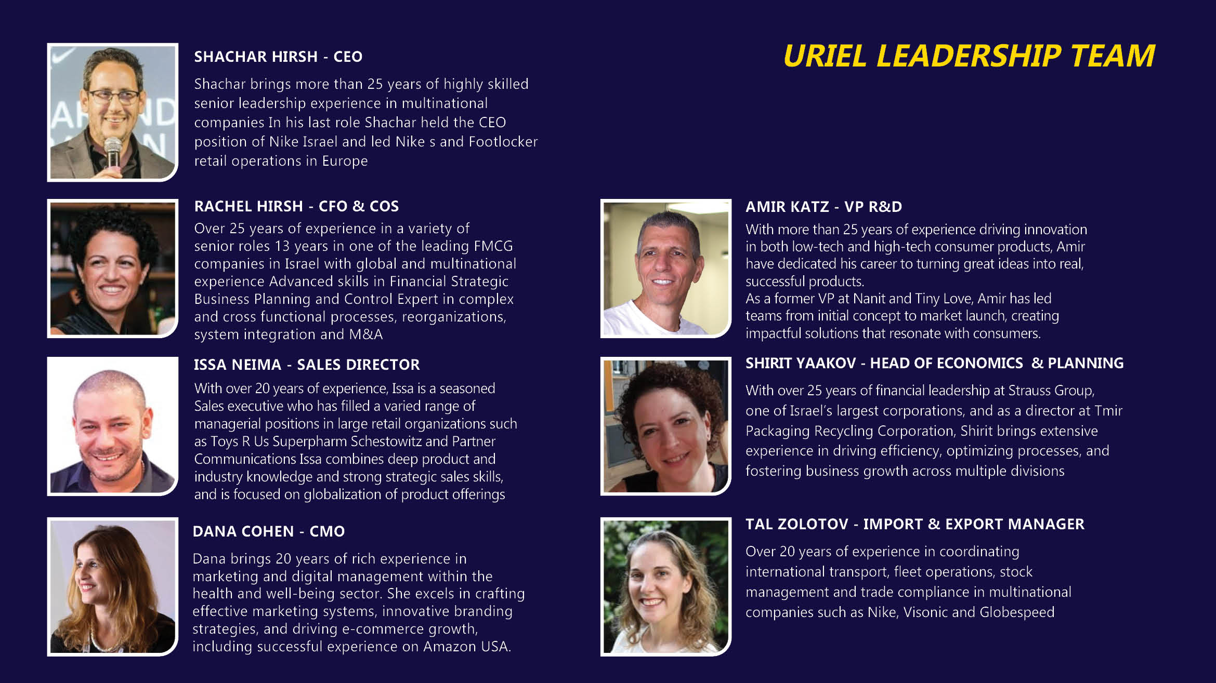

Slide 6


Slide 7
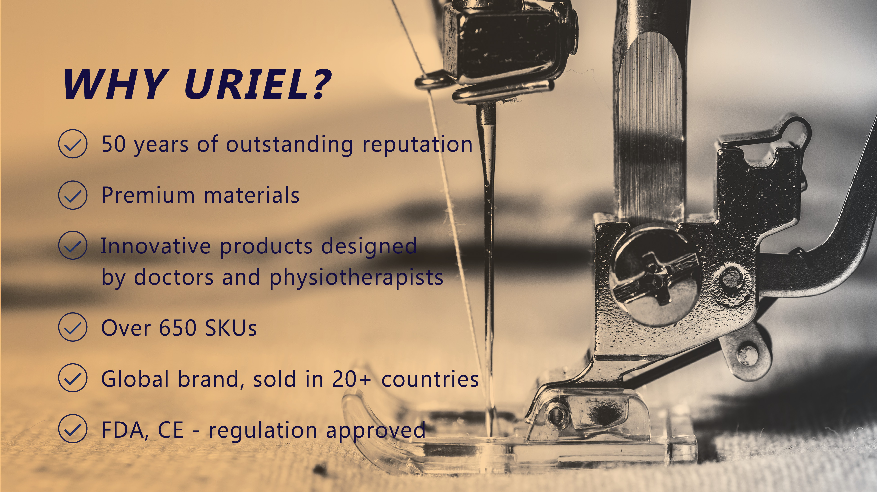

Slide 8
